Slide 1
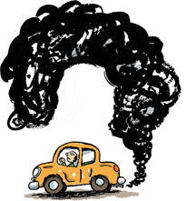
A Cleaner Car Rider Zone
No Idling at FPS!
Courtesy of Jennifer Cadwallader

Slide 2
Mr. Harris, Dr. Hall, Mrs. Wiersberg and many of the teachers at Fruitland Primary are working hard to make our school a Green School.
That means that we will be working with our students to do things that will help make the earth healthy.
Are you excited to help???

Slide 3
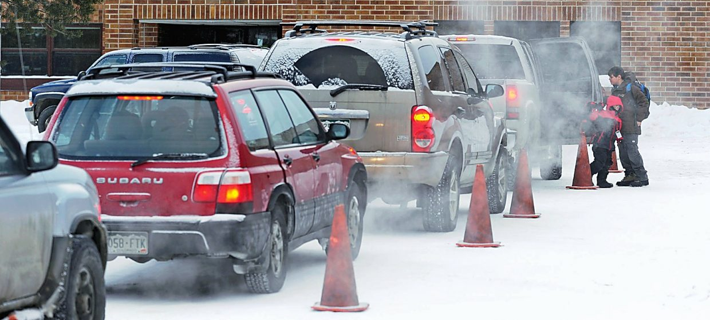
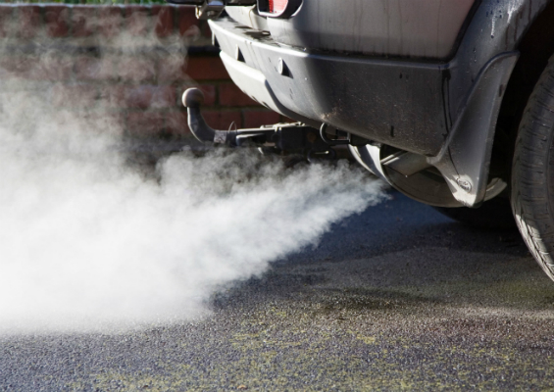
One thing we want to do is make the FPS car rider area a
NO IDLING ZONE.
Idling is when a car’s engine stays on while it is not moving.
Why is idling harmful?
The cars let out pollution, which is bad for people and animals to breathe.

Slide 4
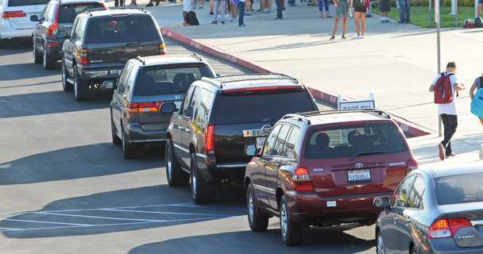
If we turn our car rider area into a no idling zone, we will save a lot of pollution from entering the air.
It’s so easy! All the parents need to do is turn off the car while they wait.
It’s your job to convince them that our no idling zone is a good idea.

Slide 5
No Idling Poster Contest
Posters
Attractive and colorful
Say No Idling Zone in big letters
Neat
First Graders gets to design posters to teach our school family how we can help the earth by having a no idling car rider zone.
Your first grade classmates and teachers will vote to choose the winners.
The winning poster design will be hung in the hallway for car rider parents to see when they sign their student out in the office. Please remind your parents to turn off their cars too.

